Slide 1
East Pacific Rise Meets N. America
Notes:
The arrival of the East Pacific Rise at the edge of North America begins the final chapter of our saga. The plate interactions that accompanied this collision ultimately led to the formation of the San Andreas fault and are shown in the following animation by Tanya Atwater.

Slide 2
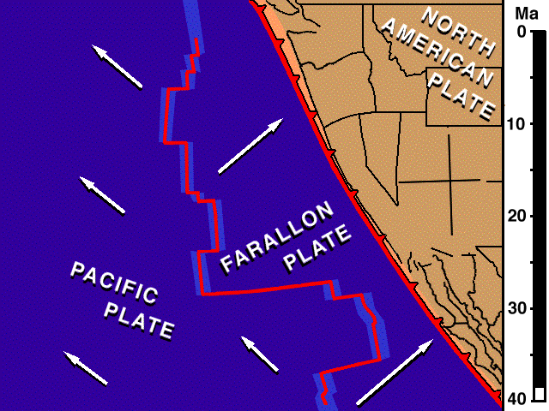
Notes:
Because the East Pacific Rise moved north as well as east, the Pacific and Farallon Plates had a northerly component superimposed on their divergence from the East Pacific Rise. The resultant motion of the Pacific Plate was therefore towards the northwest. Since this was parallel to the orientation of the trench, when the Pacific Plate arrived at the trench, the plate boundary changed from convergent to transform. As more of the Pacific Plate was brought into contact with the North American Plate, the transform plate boundary lengthened into the San Andreas Fault. The conversion to a transform plate boundary removed compressive stress on the western margin of North America, which allowed it to spread laterally while shear stress from the Pacific Plate ripped off great hunks of the North American Plate (like Baja California) and carried them to the northwest.

Slide 3
 | EVENTS | ERA
 | Termination of subduction, Thermal expansion, Tilting, Translation, Transtension, Transpression, Terracing | LATE CENOZOIC
 | Under-plating Uplift Un-roofing Undulating | EARLY CENOZOIC
 | Magmatic Madness Metamorphism | MESOZOIC
 | Stable Shelf Sedimentation | PALEOZOIC
T
U
M
S
Notes:
Represented by the “T” in SMUT, the Late Cenozoic arrival of the East Pacific Rise brought the termination of subduction and caused the thermal expansion of the lithosphere which combined with other factors resulted in differential uplift (tilting) across southern California. The arrival of the EPR also resulted in translational (sideways) motion in Southern California which is associated with both transtension (stretching) and transpression (squeezing). These factors, combined with fluctuations in sea level caused by late Cenozoic glaciation, led to the formation of marine terraces near the coast.

Slide 4
 | Termination of subduction, Thermal expansion, Tilting, Translation, Transtension, Transpression, Terracing | LATE CENOZOIC
T
Trench
East Pacific Rise
Pacific Plate
Farallon Plate remnant
Notes:
When the East Pacific Rise arrived at the trench …

Slide 5
 | Termination of subduction, Thermal expansion, Tilting, Translation, Transtension, Transpression, Terracing | LATE CENOZOIC
T
Formation of oceanic crust ends
Pacific Plate
Farallon Plate remnant
(Monterey Plate)
Path of Farallon Plate
Notes:
… production of oceanic crust ended as the accretionary wedge and forearc basin were thrust over the former spreading center. A portion of the Farallon Plate remains (now called the Monterey Plate), but the bulk of the Farallon plate continued to subduct and because no new oceanic crust replaced it…

Slide 6
 | Termination of subduction, Thermal expansion, Tilting, Translation, Transtension, Transpression, Terracing | LATE CENOZOIC
T
Uplift of PRB
Thermal expansion & plasticity
Greatest buoyancy
“anchor” removed
Tilted peneplain
Salton Trough
buoyant schist
Path of Farallon Plate
Mantle upwelling
Notes:
… mantle wells up to replace the area formerly occupied by the Farallon Plate. Upwelled mantle thermally expands the base of North American Plate making it both plastic and buoyant. Buoyancy also results from the relatively low density Catalina-Orocopia schists under-plated during the Early Cenozoic. Especially positive buoyancy occurs in the eastern Peninsular Ranges batholith where the dense anchor of lithospheric mantle was removed by subduction erosion and/or crust-mantle decoupling associated with the large amount of asthenosphere upwelled beneath the Salton Trough. Thermally-induced lower crust plasticity accommodated differential isostatic uplift which was much greater in the eastern Peninsular Ranges relative to adjacent areas such that the Early Cenozoic peneplain tilted west.

Slide 7
Ice
Water
Notes:
A much simpler, albeit less accurate, model for the uplift of the Cuyamacas can be visualized by floating a block of ice in your kitchen sink to represent the Cuyamacas floating on the mantle.

Slide 8
compression
Ice
Water
Notes:
Now press the block of ice against the edge of the sink to represent Early Cenozoic compression.

Slide 9
compression
Ice
Water
Notes:
Mesozoic magmatism and Early Cenozoic compression would have actually thickened the crust a bit, uplifting the crust’s surface while depressing it’s base into the mantle. Unless you’re a steroid-munching behemoth you won’t be able to do the same to your block of ice, but not to worry, you will still be able to get your plateau to uplift without thickening your ice.

Slide 10
compression
Ice
Water
Notes:
Now while still applying Early Cenozoic compression, melt off the top of the ice (use a blow torch, pour hot water on it or whatever) to represent erosion and peneplanation. At this point the upward buoyant force of the ice below the water is greater than the weight of the ice above the water, but the ice block will not move as long as you hold it against the side.

Slide 11
Ice
extension
Water
Notes:
If you take your hand away to represent extension… Presto! Your ice will float up! Now remember the real thing had added buoyancy from thickening at the base of the crust, thermal expansion and/or removal of the dense anchor of lithospheric mantle caused by subduction erosion , and thus uplifted even more so than your erosion-only model. Furthermore the thermally induced plasticization of the plate allowed it to flex and accommodate differential uplift where these buoyant forces were greatest (i.e. directly under the summit of the Cuyamacas).

Slide 12
 | Termination of subduction, Thermal expansion, Tilting, Translation, Transtension, Transpression, Terracing | LATE CENOZOIC
T
N. Am. Plate
Spreading in the Gulf
Pacific Plate captures Monterrey and western N. American Plates
Salton Trough
San Andreas Fault
Path of Farallon Plate
Mantle upwelling
Notes:
The Salton Trough and Gulf of California (which are not underlain by a thick, buoyant batholith like the Peninsular Ranges) sank below sea level, because a great deal of spreading occurred there which thinned the crust so much that it could not float above sea level. Spreading in the Salton Trough is caused by several factors including mantle upwelling and a brief return of arc magmatism, but perhaps most important is that unlike the Farallon Plate, the Pacific Plate is not converging with the North American plate. The Pacific Plate is moving sideways and actually slightly away from the North American plate, which gives the formerly compressed continental edge room to spread out laterally and maintain contact with the otherwise slightly divergent Pacific Plate. The absolute motion of lithosphere west of the San Andreas Fault becomes similar to that of the Pacific Plate, and therefore effectively becomes a captured portion of the Pacific Plate.

Slide 13
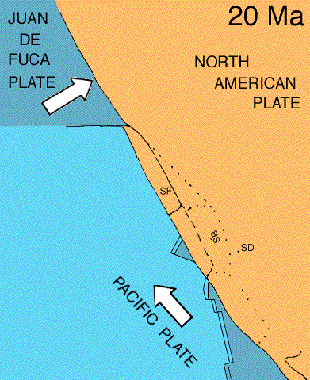
Translation
Notes:
In this animation we see how the largely sideways motion of the Pacific Plate ripped loose and captured great slabs of the western N. American Plate. Separation between these slabs, especially between San Diego (SD) and the much-rotated Santa Barbara (SB) slab, exposed the underlying Catalina-type schists which, because of their buoyancy and plasticity, flowed upwards as the confining weight of the upper crust was removed.

Slide 14
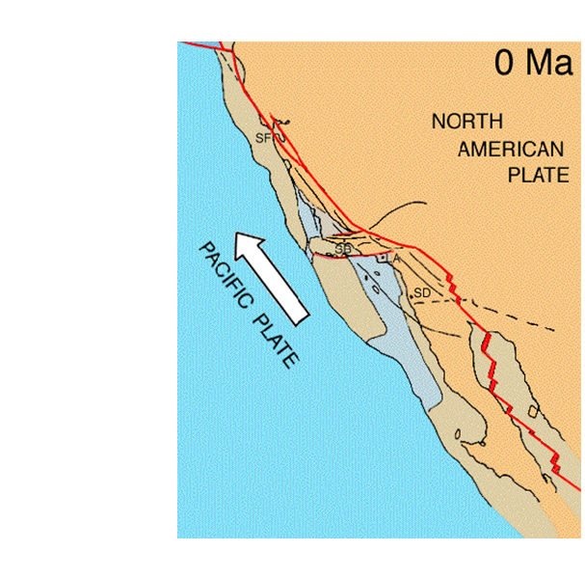
Core complex emplacement
Notes:
Such areas of exposed lower crust are known as core complexes.

Slide 15
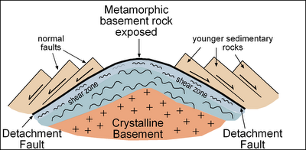
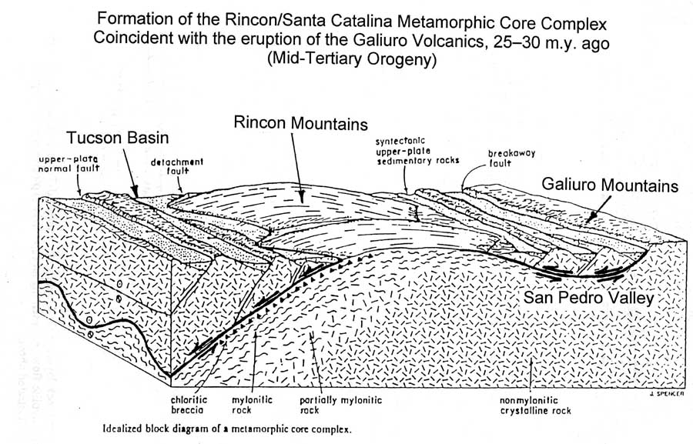
Core complex models
Notes:
There several core complex models, but all of them show the brittle upper crust rocks breaking into fault blocks which slide along a detachment fault between the brittle upper crust rocks and plastic lower plate rocks.

Slide 16
 | Termination of subduction, Thermal expansion, Tilting, Translation, Transtension, Transpression, Terracing | LATE CENOZOIC
T
Core complex (Orocopia schist)
Core complex (Catalina schist)
Salton Trough
San Andreas Fault
Path of Farallon Plate
Mantle upwelling
Notes:
Such is the case in the jumbled California continental borderland where the Catalina schist comprises the core complex. Tensional thinning of the upper crust near the Salton Trough releases a similar Orocopia schist-composed core complex in the Orocopia Mts. near the San Andreas Fault.

Slide 17
Decompression Melting and Basaltic Magmatism
Continental Borderland
Peninsular Ranges
Salton Trough
Decompression melting
Notes:
Compared to the Peninsular Ranges, the lithosphere is much thinner in the Salton Trough and Southern California continental borderland so upwelled mantle can rise much closer to the surface in those areas. Thus decompression melting takes place in these areas, producing basaltic magma that works it’s way towards the surface. Some is emplaced as small, shallow plutons, but the thin crust allows much of the basaltic magma to reach the surface where most of it becomes buried beneath sediment which is especially thick in the Salton Trough.

Slide 18
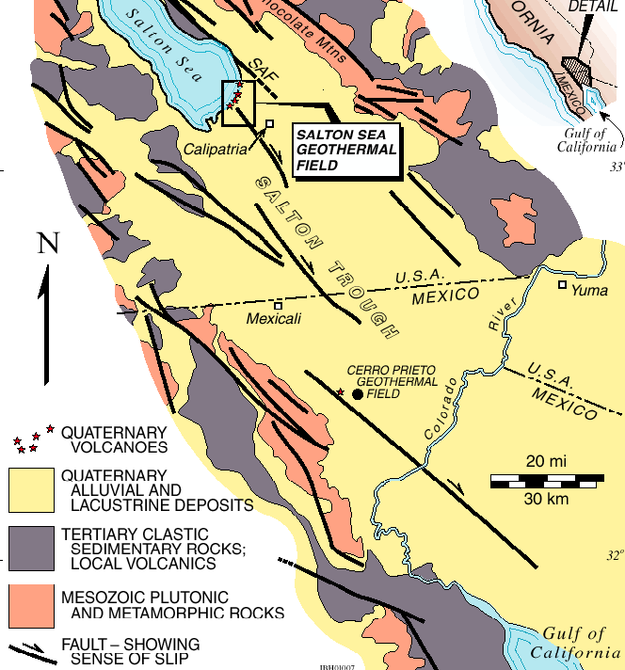
Notes:
In the Salton Trough we see the effects of late Cenozoic volcanism in many areas, but especially where the crust is stretched super thin such as along the southern edge of the Salton Sea.

Slide 19
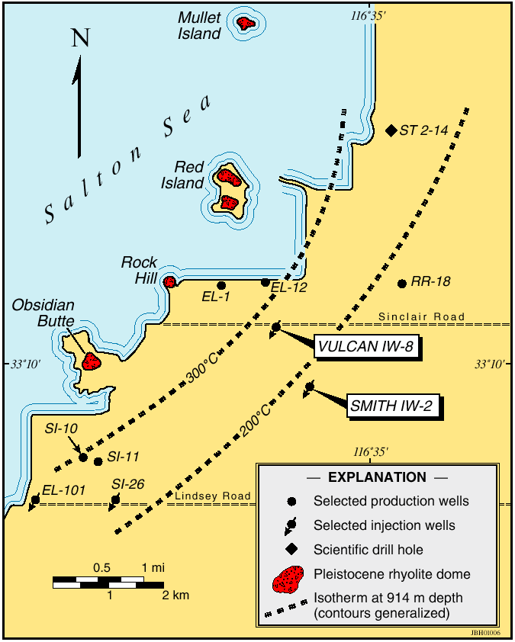
Notes:
Here a series of volcanic domes formed from the eruption of thick, silica-rich magma that formed as sediments in the basin melted on contact with hot basaltic magma that rose from the decompressing mantle below.

Slide 20
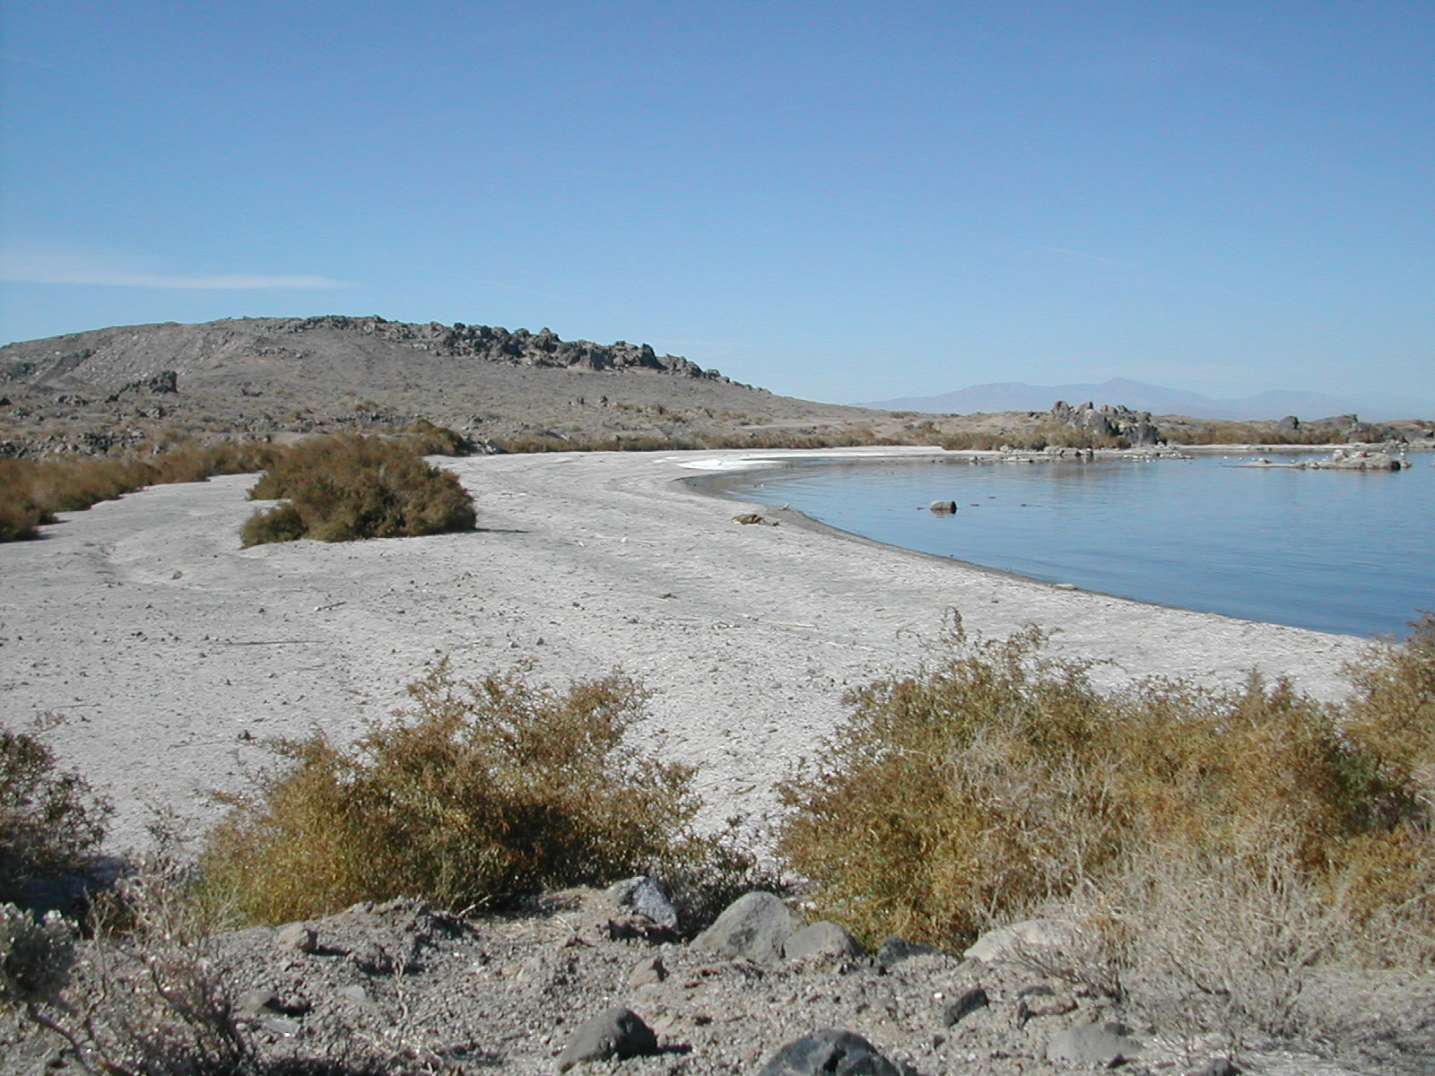
Notes:
One of these domes is Obsidian Butte …

Slide 21
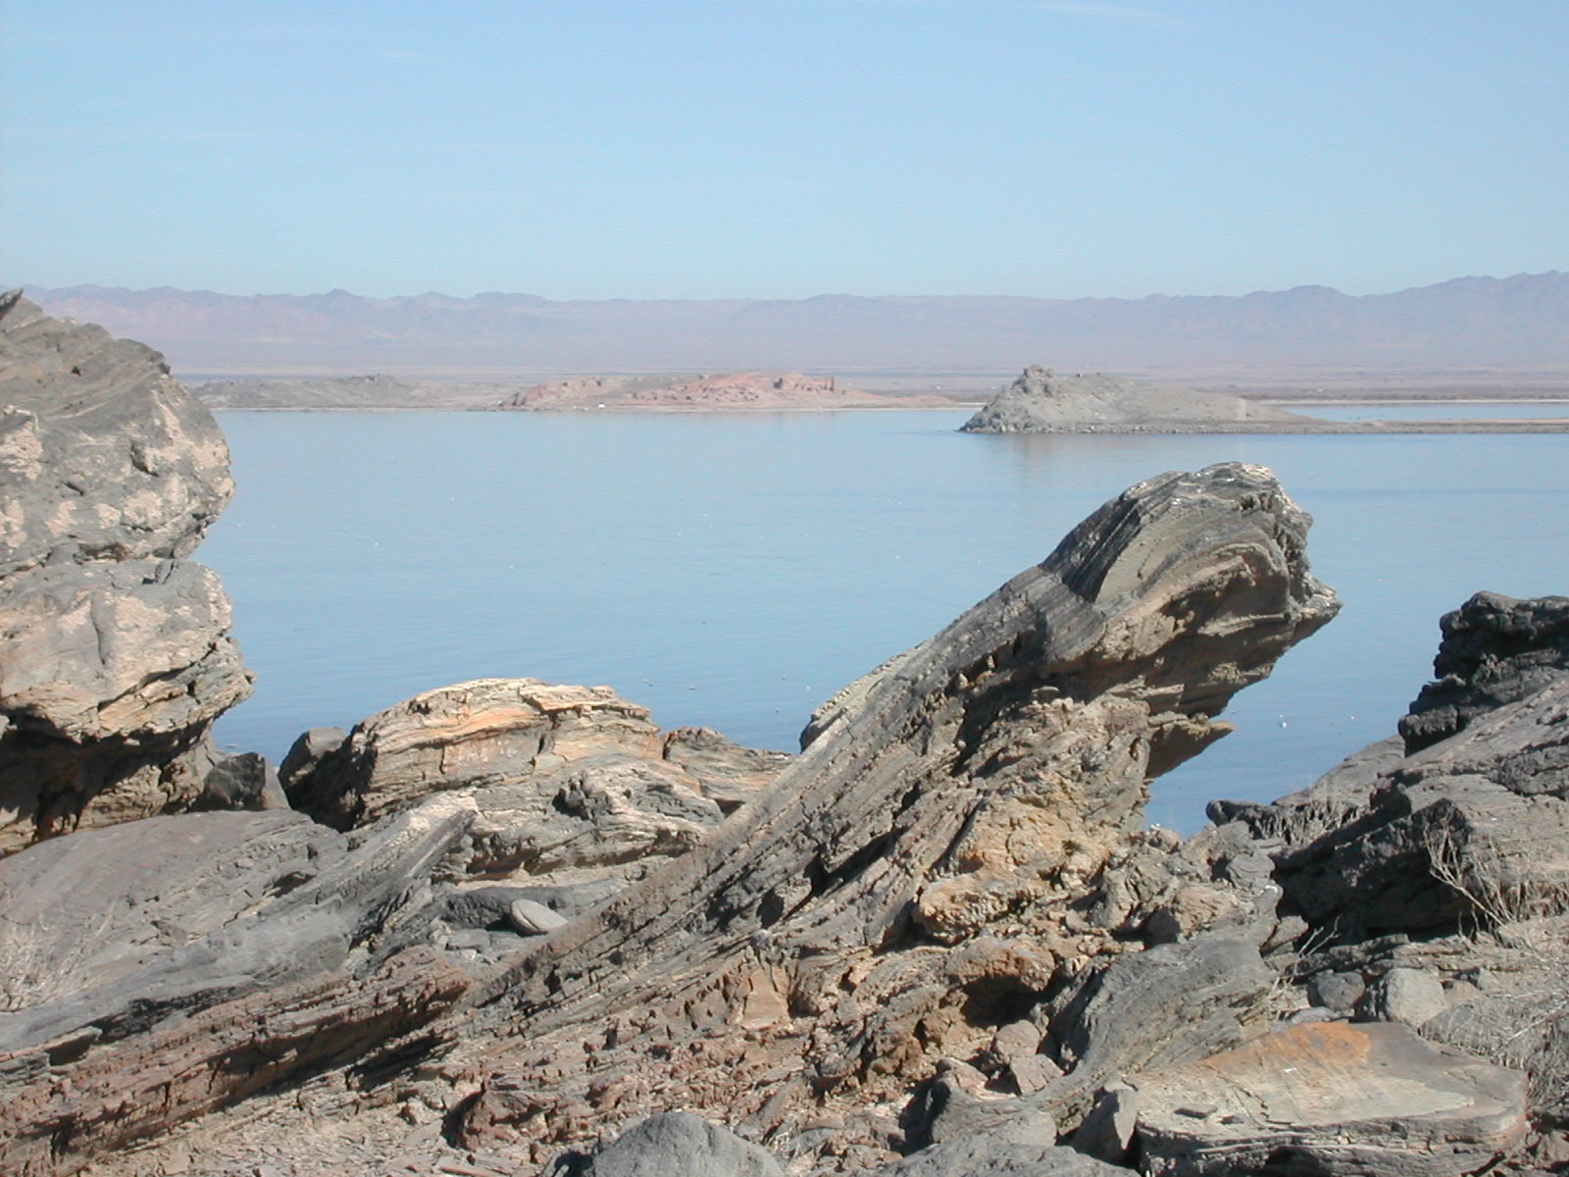
Notes:
… where one can look across from flow-folded layers of obsidian and pumice to three other domes at Rock Hill and Red Island.

Slide 22
Notes:
The mantle is very close to the surface here, so at a relatively shallow depth superheated groundwater exists …

Slide 23
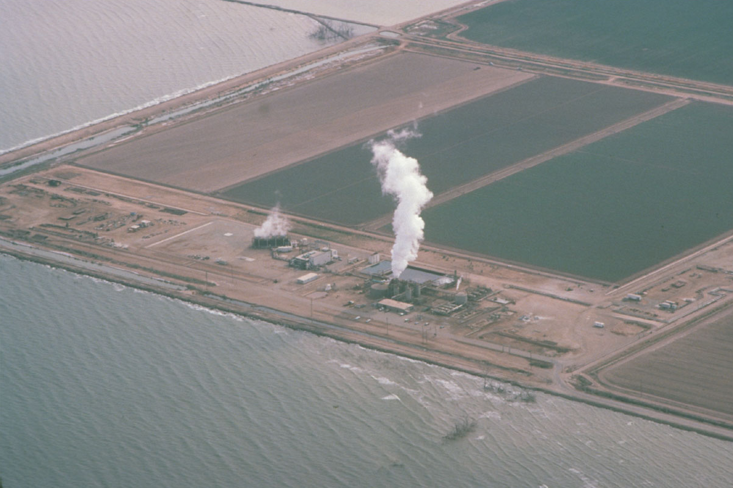
Notes:
… whose energy is tapped by numerous geothermal wells in the area.

Slide 24
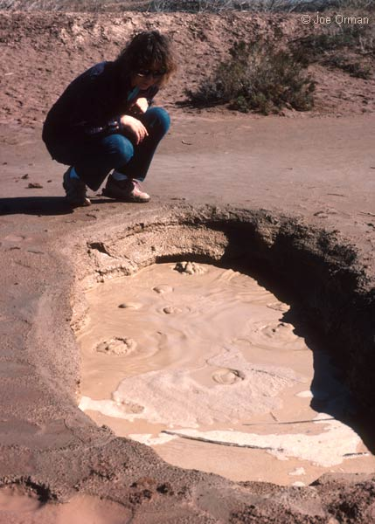
Notes:
The hot groundwater rises to the surface and alters the basin sediments into clay in a few places forming mud pots …

Slide 25
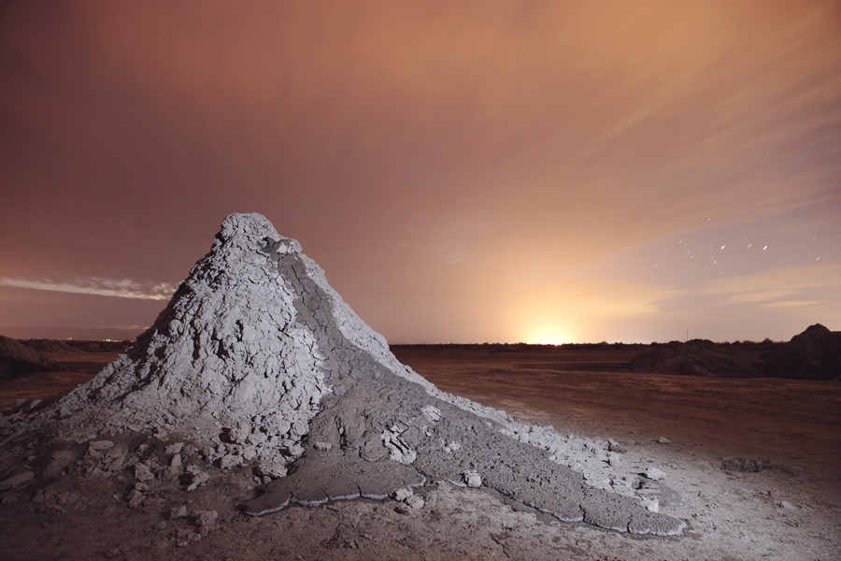
Notes:
… and mud volcanoes.

Slide 26
Decompression Melting and Basaltic Magmatism
Continental Borderland
Peninsular Ranges
Salton Trough
Decompression melting
Notes:
Late Cenozoic volcanism can also be seen in the thin crust west of the Peninsular Ranges …

Slide 27
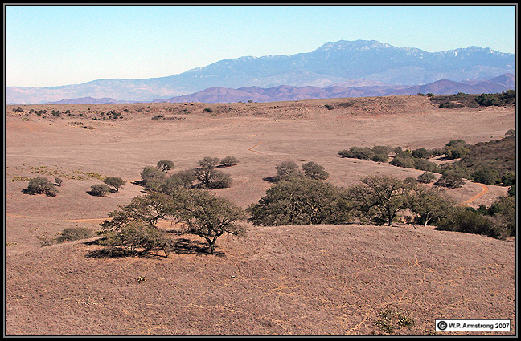
Notes:
… as the basalt flows that cap the Santa Rosa plateau,

Slide 28
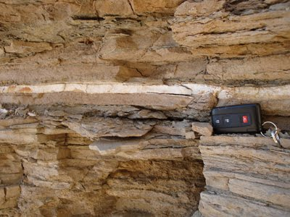
Notes:
…. and as ash layers …

Slide 29
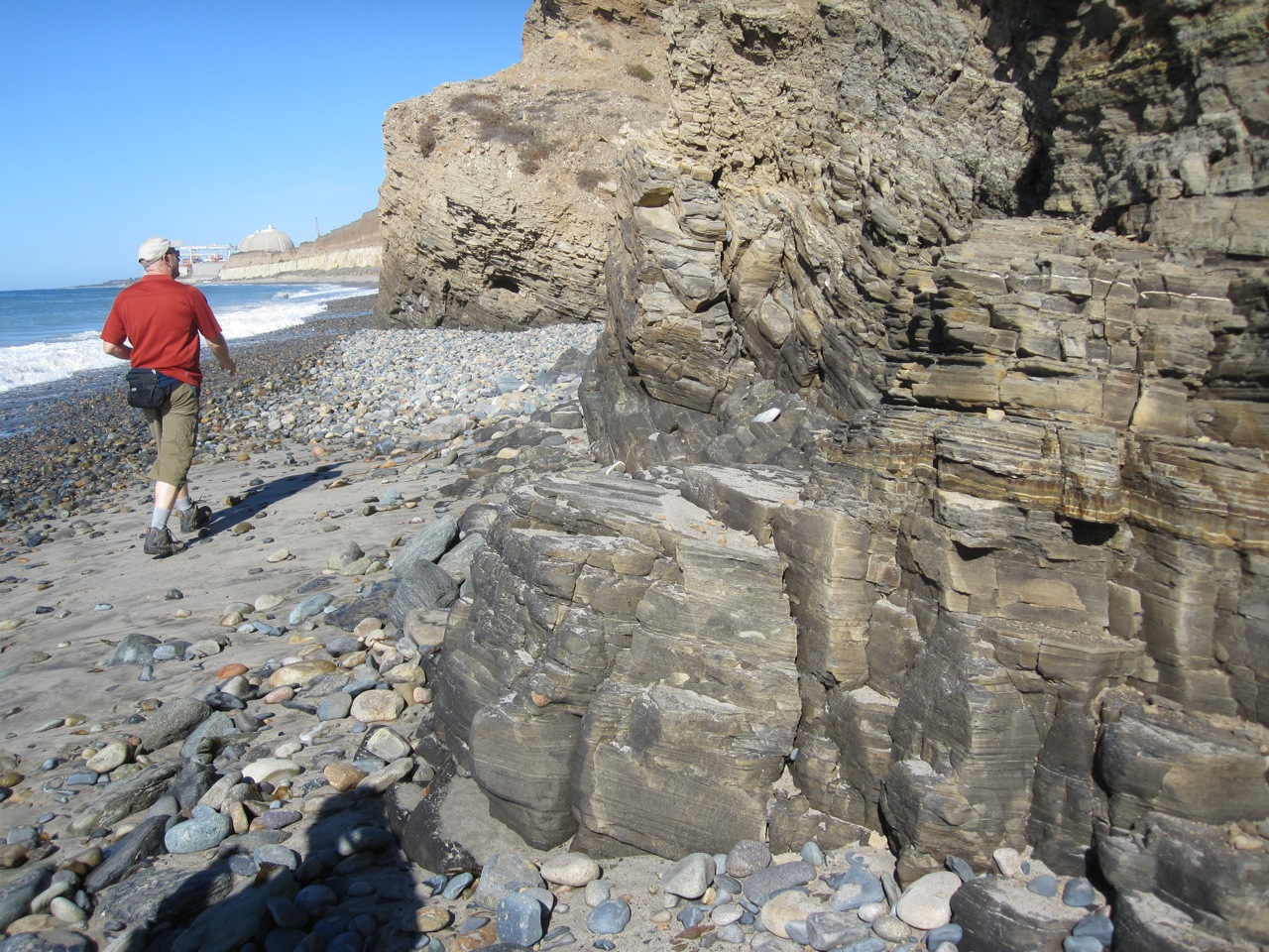
Notes:
… in the Monterey Shale at San Onofre State Beach.

Slide 30
Structural Effects
 | Termination of subduction, Thermal expansion, Tilting, Translation, Transtension, Transpression, Terracing | LATE CENOZOIC
T
Continental Borderland
Peninsular Ranges
Salton Trough
Decompression melting
Notes:
Volcanism adds a fascinating component to the Late Cenozoic, but the arrival of the Pacific Plate had far more widespread structural effects across Southern California.

Slide 31
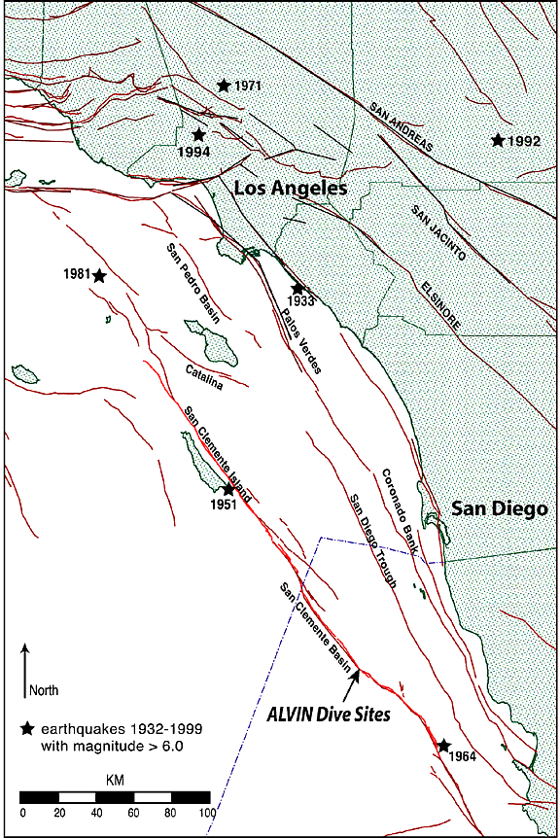
Notes:
Most notable of these is the initiation of the San Andreas fault system. Although motion along these faults is primarily sideways, where bends occur …

Slide 32
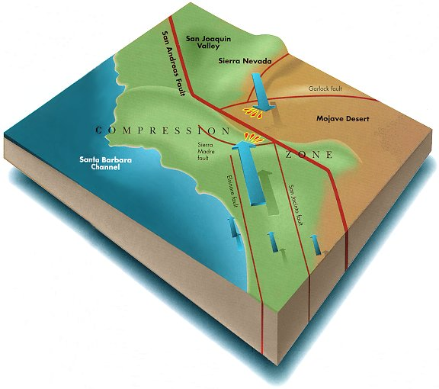
Notes:
... localized compression or extension will occur.

Slide 33
Translation
Translation
Notes:
Looking down now on a bend along a right lateral strike slip fault, we can see that, depending on which direction the fault bends, localized areas of compression and extension will occur.

Slide 34
Transpression
Transtension
Notes:
Compression associated with lateral fault motion is known as transpression and the corresponding extension is called transtension.

Slide 35
Thicker crust
Thinner crust
Notes:
Crust tends to thicken in areas of transpression, while crustal thinning occurs where there is transtension.

Slide 36
Uplift
Subsidence
Notes:
Transpressional areas therefore tend to undergo uplift and ridge formation, while transtension causes subsidence and the formation of basins.

Slide 37
Ridge
Basins fill with volcanics and sediments
Notes:
Because crustal thinning contributes to the decompression of the underlying mantle, basaltic magma tends to form beneath the transtensional basins. Such magma reaches the surface as various volcanic rocks which fill the basin along with marine and/or continental sediments. Since there can be several miles of displacement along lateral faults like these, fault patterns and corresponding stresses can completely change, such that an area that once experienced transtension can later experience transpression. Thus the volcanic and/or sedimentary rocks that once filled a transtensional basin may be later uplifted as a transpressional ridge.

Slide 38
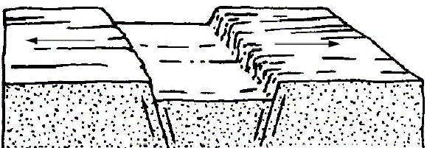
A Simple Graben formed by Transtension
Notes:
Such is the case at Split Mountain. Transtension formed a basin there about 8 million years ago ….

Slide 39
Sediment fills Graben
Notes:
… which filled with sediments by about 4 million years ago.

Slide 40
Fish Creek Crosses Filled Graben
Notes:
Transtension stopped and a stream flowed across the filled basin.

Slide 41
Stress Patterns Change to Transpression
Notes:
Then stress patterns changed to transpression, ….

Slide 42
Crust Shortens and Sediments Fold
Notes:
… which folded the basin sediments upward into the Fish Creek Mountains while the stream more or less maintained its original level by eroding through the uplifted sediments.

Slide 43
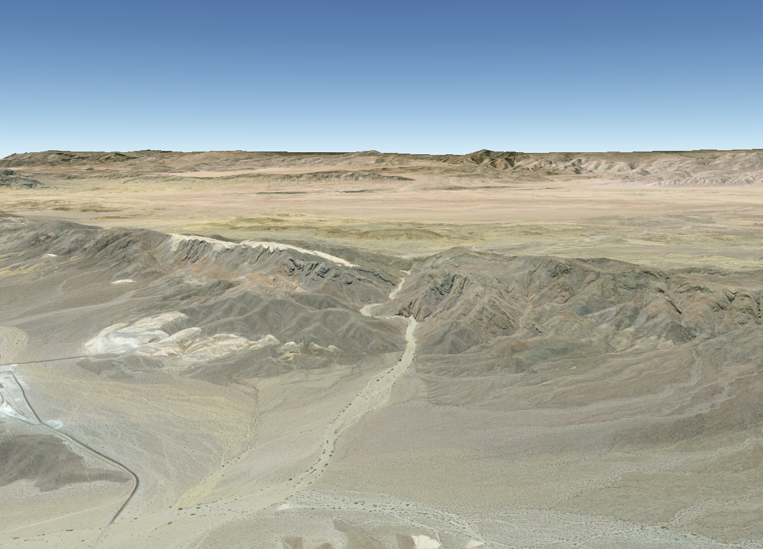
Fish Creek Cuts Canyon Across Folded Sediments
Notes:
The result is Split Mountain Gorge,

Slide 44
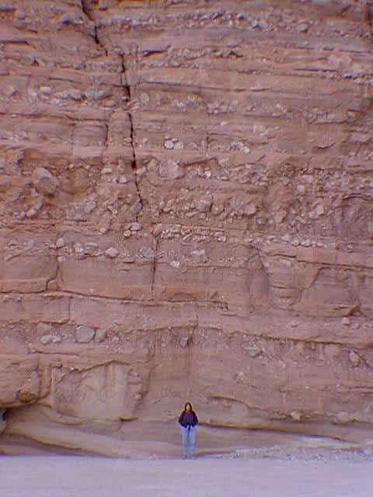
Notes:
… which exposes in its canyon walls a world class record of the various sediments that filled a transtensional basin …

Slide 45
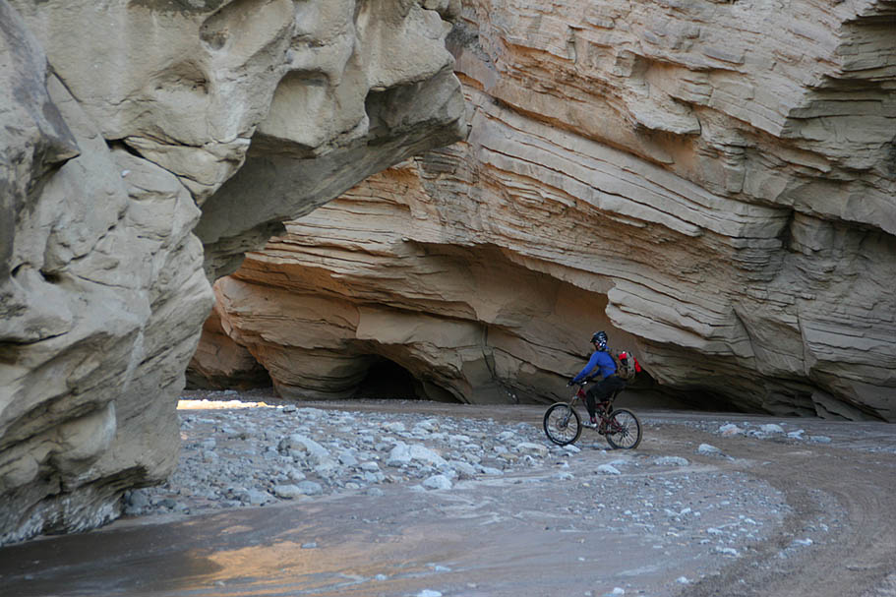
Notes:
… and later were pushed up as a transpressional ridge.

Slide 46
 | EVENTS | ERA
 | Termination of subduction, Thermal expansion, Tilting, Translation, Transtension, Transpression, Terracing | LATE CENOZOIC
 | Under-plating Uplift Un-roofing Undulating | EARLY CENOZOIC
 | Magmatic Madness Metamorphism | MESOZOIC
 | Stable Shelf Sedimentation | PALEOZOIC
T
U
M
S
Notes:
Some of the most spectacular displays of transtension and transpression,

Slide 47
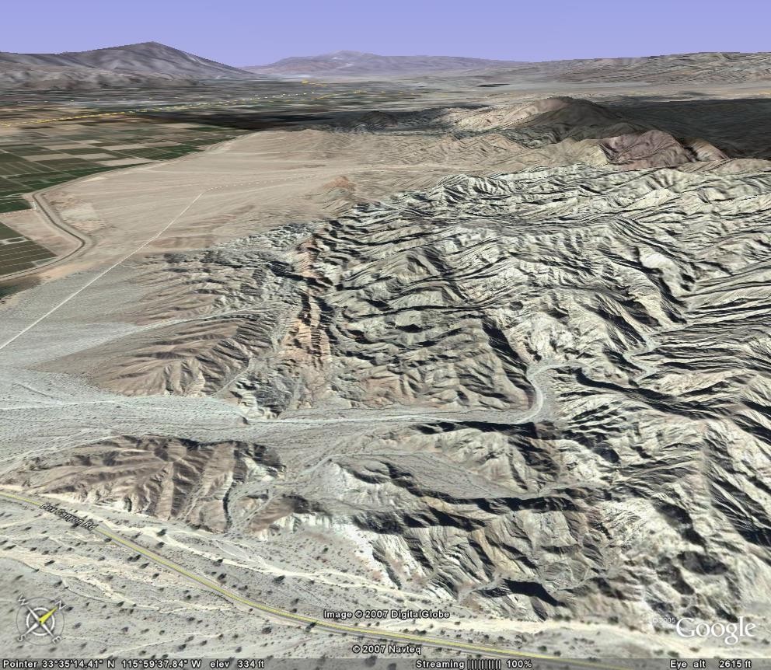
Transpression
San Jacinto
Transverse Ranges
San Andreas Fault
Mecca Hills
Notes:
… are found along the San Andreas Fault where a major bend caused the transpression which uplifted San Jacinto Mountain and the Transverse Ranges. Similar transpression uplifted the Mecca Hills,

Slide 48
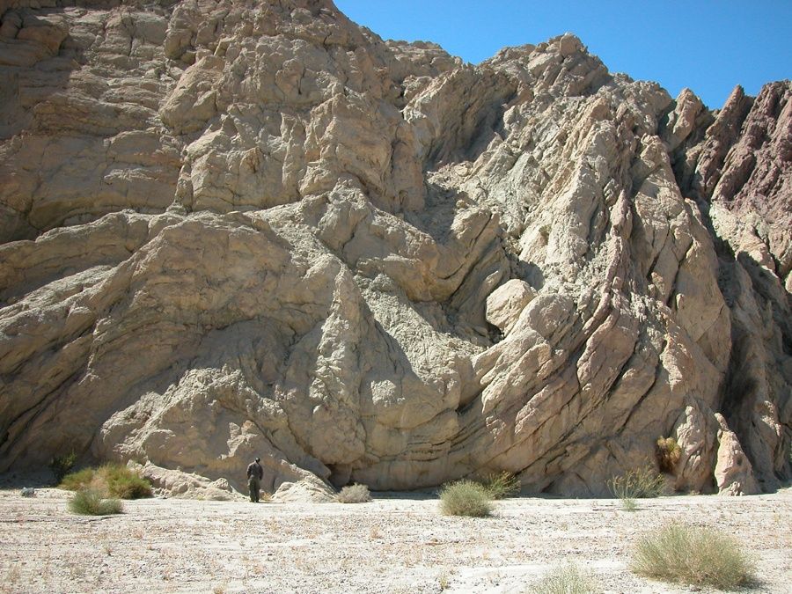
Notes:
… where erosion along Painted Canyon has exposed spectacular folds in the compressed strata.

Slide 49
Structural Effects
 | Termination of subduction, Thermal expansion, Tilting, Translation, Transtension, Transpression, Terracing | LATE CENOZOIC
T
Below Sea Level
Continental Borderland
Peninsular Ranges
Salton Trough
Notes:
Transtension across the Salton Trough lowered the region to below sea level, giving the Colorado River a low place to flow towards,

Slide 50
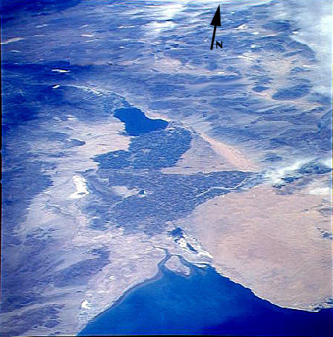
Notes:
… where eventually it built a delta that blocked the Gulf of California from entering the Salton Trough.

Slide 51
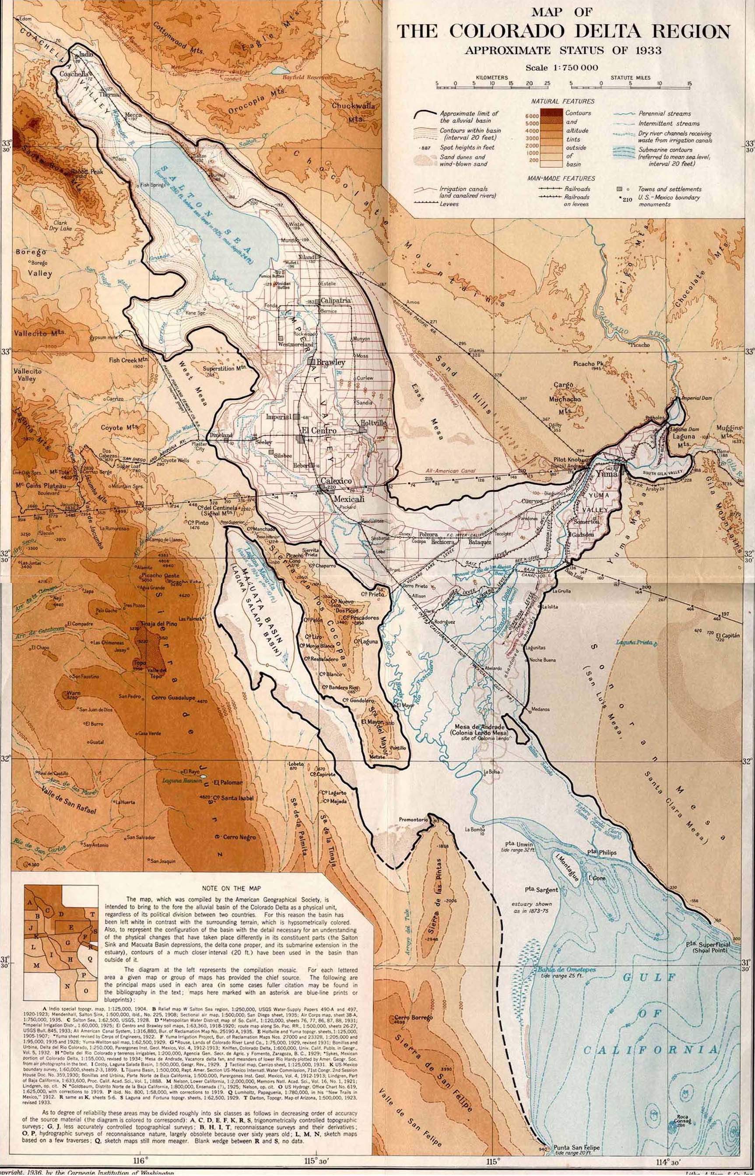
Notes:
Since the Colorado River periodically shifted its course from one side of the delta to the other …

Slide 52
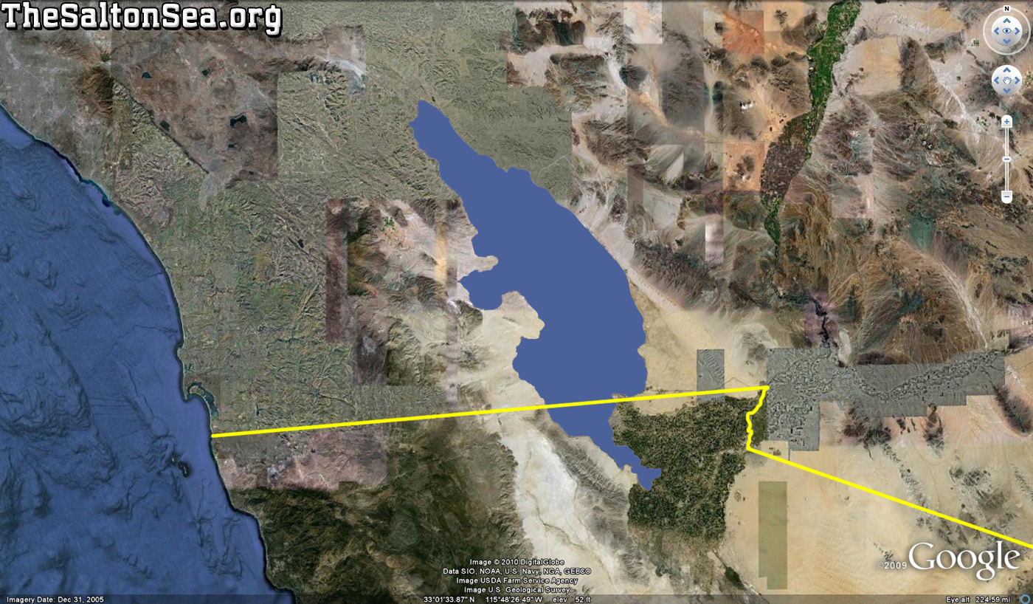
Lake Cahuilla
Notes:
… a large freshwater lake periodically filled and dried up in the Salton Trough. Ancient Lake Cahuilla,

Slide 53
Notes:
… filled and drained several times and had a small amount of water in it when Spanish explorers arrived in 1540. Water levels in the lake top out at about 40 feet above sea level because at that point lake water spills over the Colorado River delta into the Gulf of California.

Slide 54
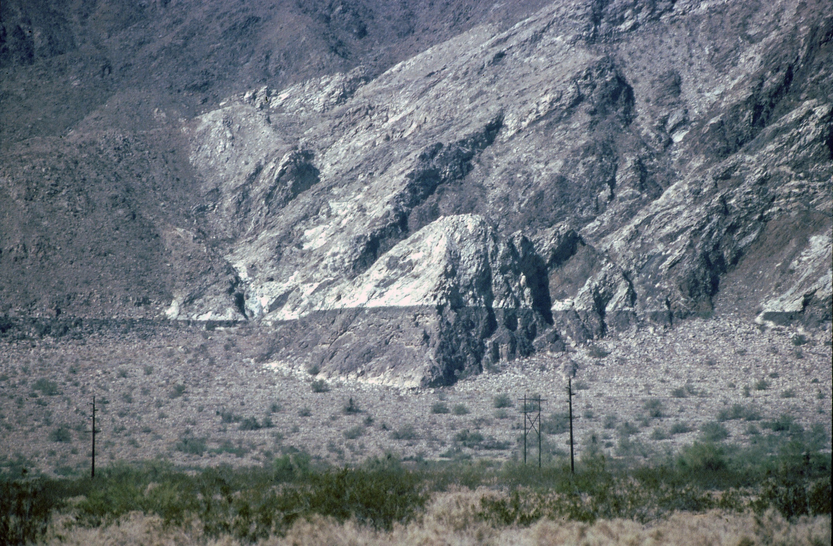
Travertine
Notes:
Thus a clearly visible “bathtub ring” of travertine occurs at and just below the overflow level.

Slide 55
 | Termination of subduction, Thermal expansion, Tilting, Translation, Transtension, Transpression, Terracing | LATE CENOZOIC
T
Core complex modified by transtension and transpression
Salton Trough
San Andreas Fault
Path of Farallon Plate
Mantle upwelling
Notes:
Transtension and transpression also affected the Pacific side of the Peninsular Ranges where transtensional basins and transpressional ridges where superimposed on core complex structures.

Slide 56
Continental Borderland
Notes:
The jumble of basins, ridges and islands in the southern California continental borderland is the dramatic consequence of the combined action of core complex detachment faulting, transtension and transpression on thin continental crust. In mainland coastal areas where the crust is thicker, uplift generally occurred, but far less than in the central portion of the Peninsular Ranges. Combined with fluctuations in sea level during the Pleistocene glacial ages this led to the formation of …

Slide 57
 | EVENTS | ERA
 | Termination of subduction, Thermal expansion, Tilting, Translation, Transtension, Transpression, Terracing | LATE CENOZOIC
 | Under-plating Uplift Un-roofing Undulating | EARLY CENOZOIC
 | Magmatic Madness Metamorphism | MESOZOIC
 | Stable Shelf Sedimentation | PALEOZOIC
T
U
M
S
Notes:
… marine terraces near the coast.

Slide 58
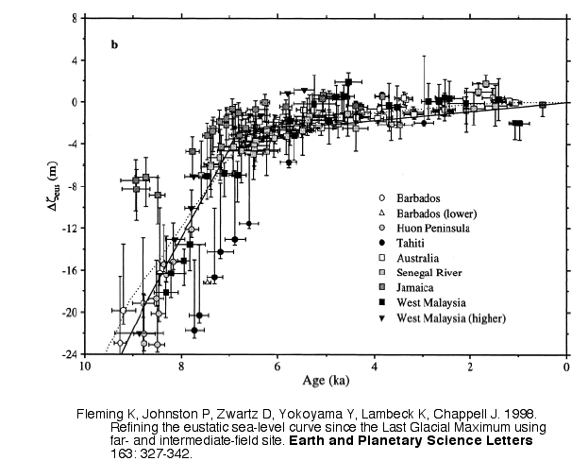
slow rise
rapid rise
Notes:
This graph illustrates one of the key principles in marine terrace formation. It shows the rise in sea level since the last ice age 10,000 years ago. Notice that the rate of change was very rapid for about 3,000 after the last glacial period, but then it stabilized, and has only risen slightly over the last 7,000 years. Similarly, when headed into a glacial period, sea level falls rapidly at first and then stabilizes at the lower glacial sea level.

Slide 59
Marine Terrace Formation
(click icon to see animation)
Notes:
Notice the rapid rise, stabilization, rapid fall and stabilization again of sea level. When sea level is stable, wave erosion forms a wave cut platform at the shoreline. This will happen during both during low and high sea level stands. But as wave cut platforms form and sea levels change, the land slowly uplifts, such that older wave cut platforms are elevated above younger platforms. The elevated wave cut platforms are now called marine terraces. Usually marine terraces will occur at several at different elevations, forming massive coastal stairways, with the lowest steps being the youngest. Level ground near the coast is irresistible to developers, but the “prime” beach front lots may not be excellent long term investments.

Slide 60
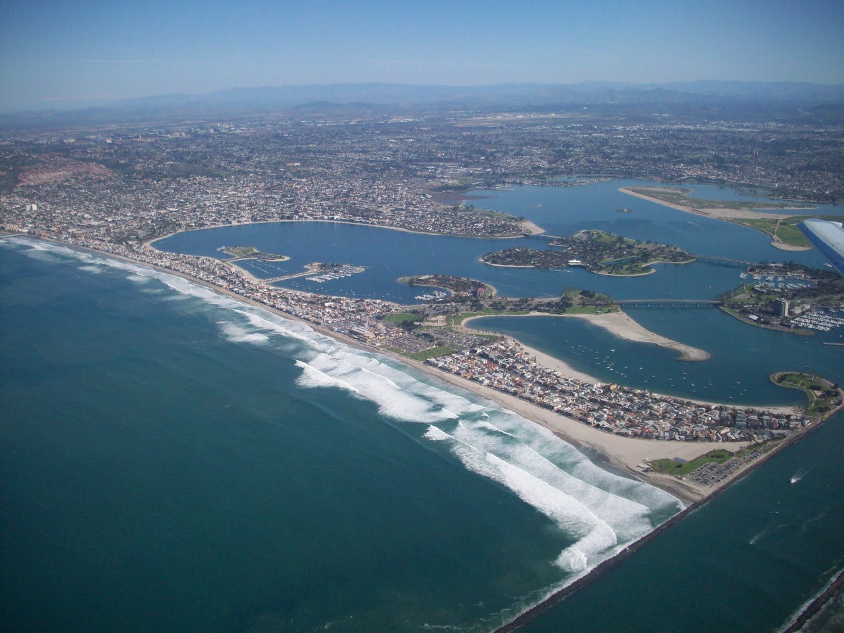
Notes:
Much of the flatness seen along the San Diego coast can be attributed to the formation of marine terraces.

